Slide 1


Go
Around Jilin University
whoops team
Project Manager：Chen Ziming
Members：Du Xiaolong, Gao Xianjun, Wang Yu

Slide 2

CONTENTS
01
Description of the Project
02
Procedure
03
Demo of DKG

Slide 3

PART ONE
Description of the Project

Slide 4
DECRIPTION OF PROJECT
The idea comes from:
the lives of JLU students are too boring
they need to find ways to entertain themselves.
But the problem is:
so many recreation places, saying, scenic spots, restaurants, cinemas
difficult to manage a route due to the complexity of querying data.
Our goals is:
By stating the key words, like Sichuan cuisine or scenic places
recommend related places(nearby, ...) under their own circumstances(prices, time,key words)
more information about these place(dynamic routes, tags)

Slide 5
DECRIPTION OF PROJECTI
A DKG in the process of decision for JLU students
most suitable places for them based on the
distance and price.
Detecting the best route for them

Slide 6
PART TWO
Procedure

Slide 7
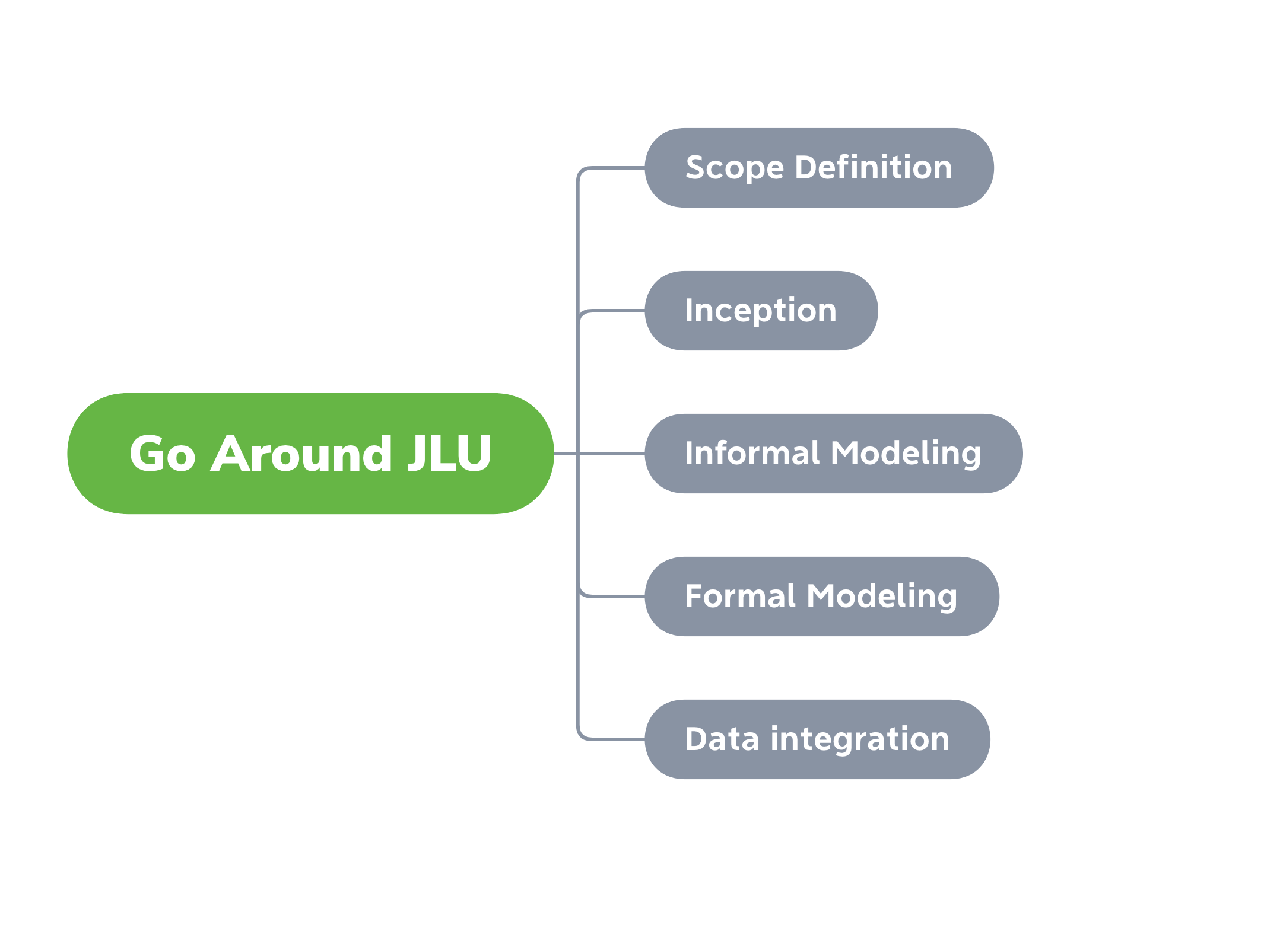

Slide 8
Scope Definition
Finished by Chen Ziming
define the purpose and the scope of work
Changchun

Slide 9

Scope Definition
Scenarios
Chen Ziming & Du Xiaolong
Problem
Repetition of functionality and similarity
Most struggling part is:
? conflicts between the required data and accessible data
On the one hand, try our best to get data
On the other hand, remove some function where data is hard to retrieve and is kind of inpractice

Slide 10
Scope Definition
Scenarios
Chen Ziming & Du Xiaolong
Chen Ziming & Wang Yu

Slide 11
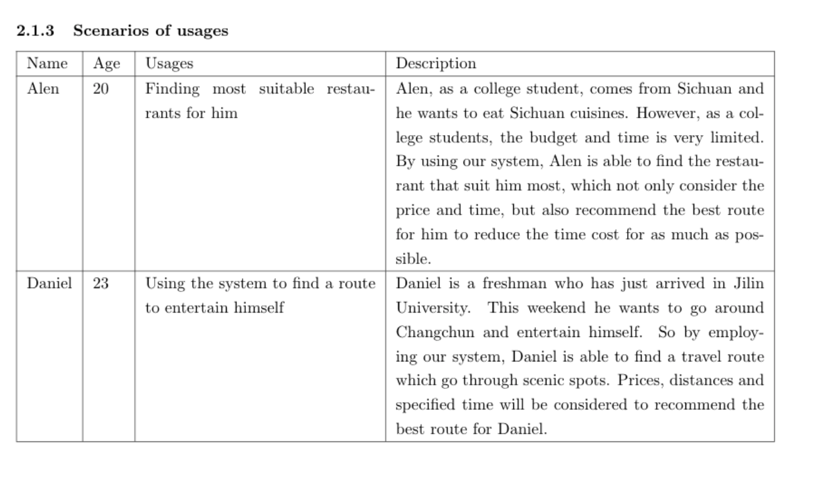
Scope Definition
Alen and Daniel

Slide 12
Inception
Competency Queries
Chen Ziming & Wang Yu
Progressive
Process of that helps the customer clarify his own needs.

Slide 13
Inception
initial datasets description and datasets collection process
Gao Xianjun & Chen Ziming
following websites are chosen as reference.
www.amap.com,
give us routes depending on start place and end place
www.cc.meituan.com.
a large comment website
provide the detailed information about, restaurant, cinema, etc.
www.ctrip.com.
search corresponding information with a specify tag.

Slide 14
Inception
datasets collection process
A crawler in Python.
How it work?
get the source code of the website
locate the section which records the tourist information by the regular expression. json language
by searching the specified tag, we can obtain the information

Slide 15
Informal Modeling
EER Model definition
Wang yu & Du Xiaolong
ER diagram design:
extract object class,
determine the attributes

Slide 16
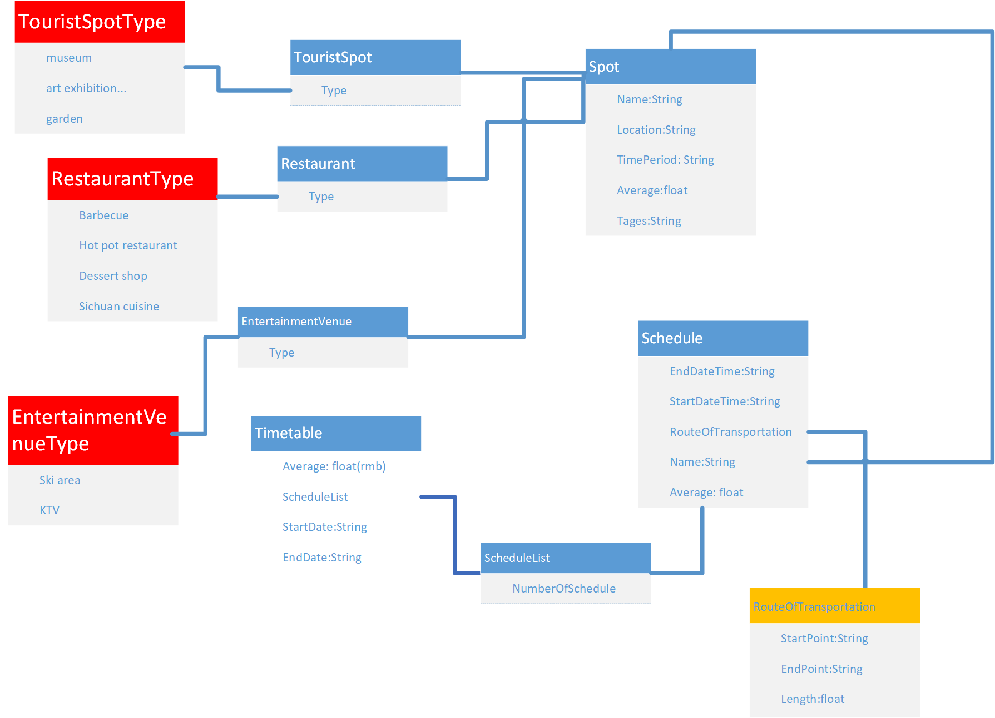

Slide 17
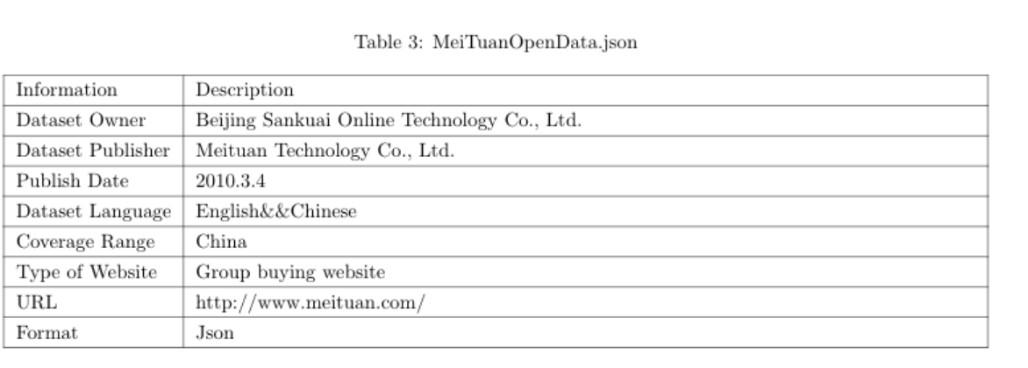
informal Modeling
Datasets metadata documentation
Gao Xianjun

Slide 18
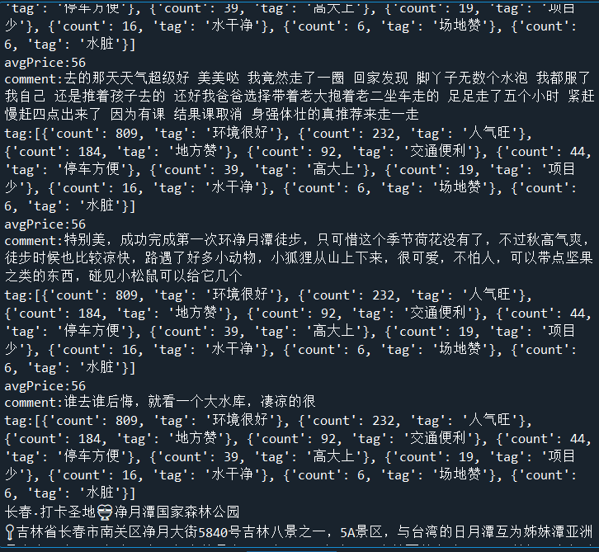

Slide 19
Informal Modeling
datasets management process
Get rid of useless information
stored as a CSV

Slide 20


Formal Modeling
Ontology definition
Du Xiaolong & Wang Yu
search for common entities from the DBpedia.
compare the terms in our ER module with the ones already present on UKC to make the our ER module more explicit and standardized.
Avg_cost
Average

Slide 21
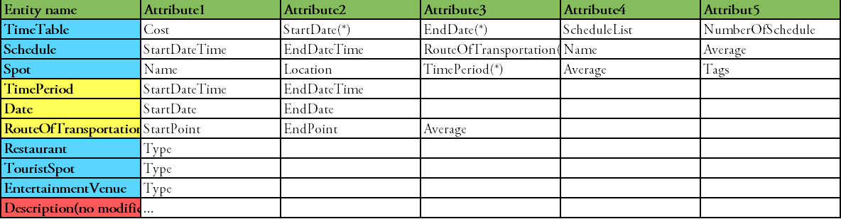
Formal Modeling
Ontology definition
Entity table after term normalization

Slide 22
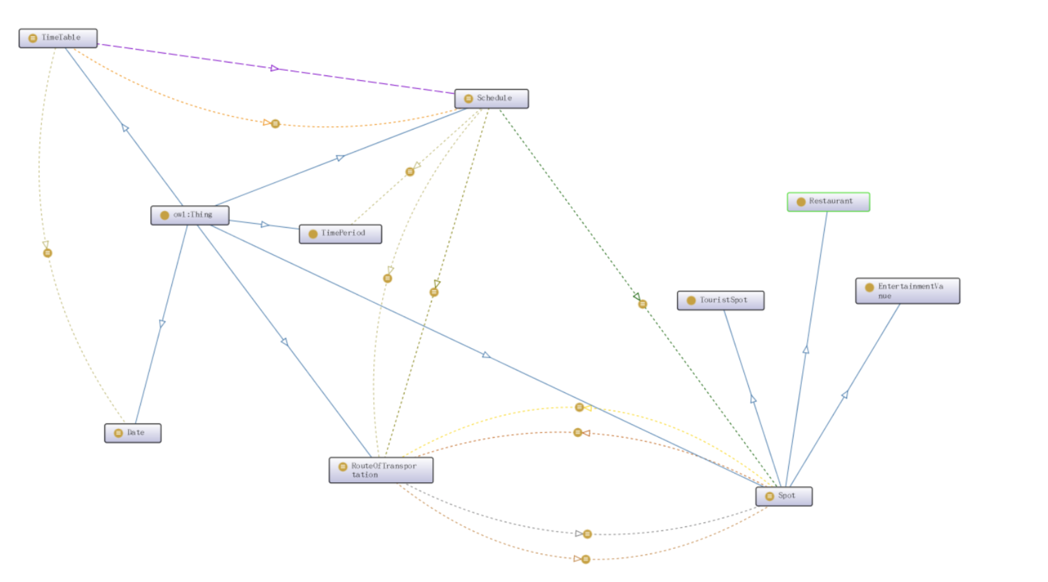
Formal Modeling
Ontology definition
Based on the ER diagram we map the entity into class, and build the data property and object property by protégé.
we evaluate and modify module according to the data and export it to owl / XML file.

Slide 23
Data Integration
Gao Xianjun
karma to integrate the owl file and the csv file.
two files were imported into karma.
map each data label in the csv file to its corresponding property and classPage in the owl file.
set its foreign key for each class in the owl file.
complete the mapping between the data in the csv file and the ontology in semantic in owl

Slide 24
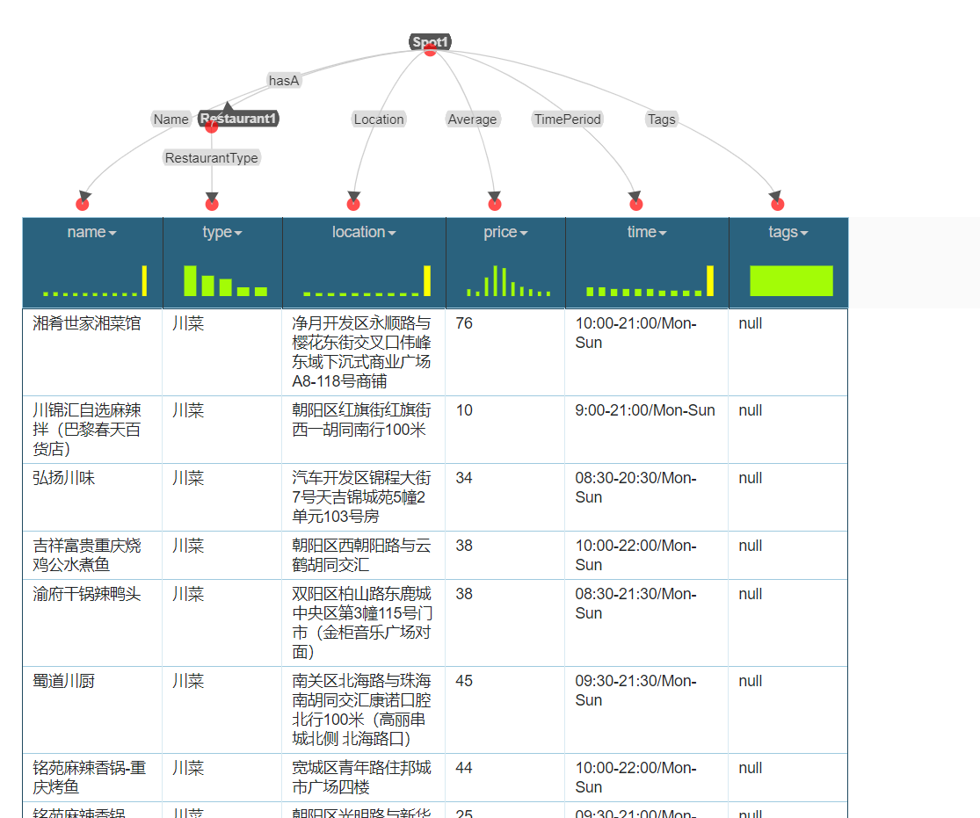

Slide 25
PART THREE
Demo of DKG

Slide 26
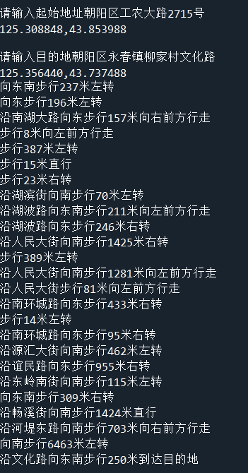
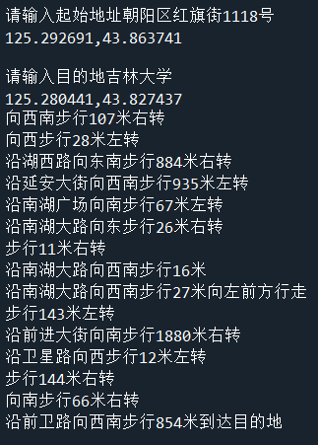

Slide 27
THANKS!
whoops_team

